Slide 1
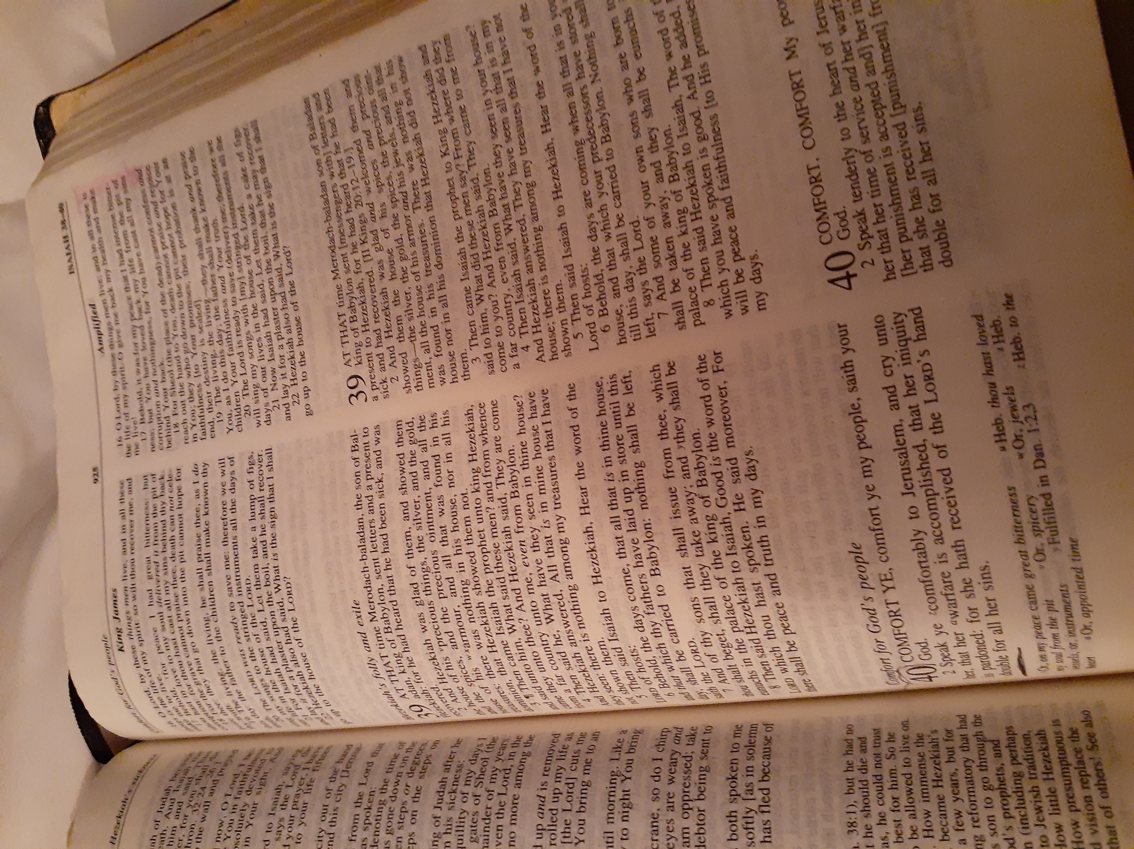

Prepare Ye the Way
The Path out of the wilderness (darkness, world, without GOD) has already been prepared; one must choose to be lead.

Slide 2

TIME …. Ecclesiates 3

Slide 3
TIME
Time is a commodity and only God can redeem it, so don't waste it. Insanity is doing exactly the same thing looking for a different result.

Slide 4
We must all change our own ways, our own thoughts, and our own deeds led by the Word of God and the Holy Spirit. We must grow up IN Christ and let go of our way of doing things.
It is not working and we are wasting time.

Slide 5
God desires to show us a more excellent way so we must ask for wisdom and discernment in this hour and simply obey, and rest IN him. For only he knows the beginning and the end.
Receive your new beginning by allowing him to strip you like an onion and surrendering to his leading.

Slide 6
Let LOVE set us free so can walk in our promised land. Amen and amen.
Annamadams.co

